Slide 1


Slide 2









Mission and vision
Mission
Our mission is to empower people by providing a platform that enables authentic & engaging connections in love, life, and work.
Vision
Our vision is to foster a world where individuals can form authentic, inclusive, and empowering connections in all aspects of life.

Slide 3
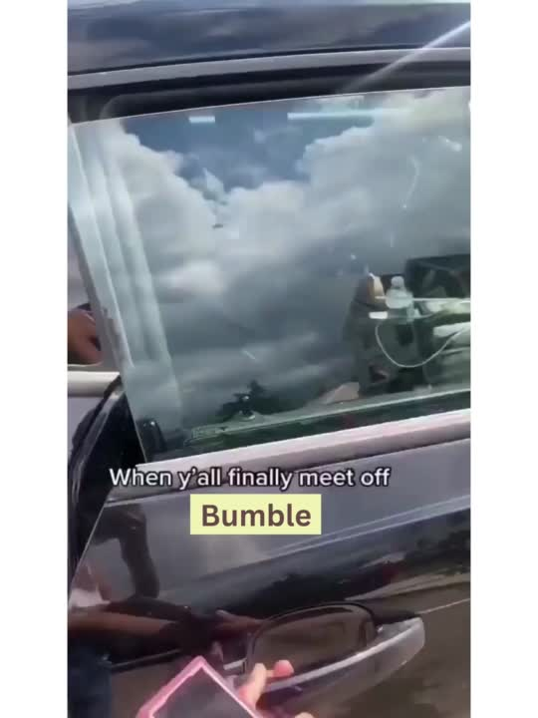
Problem Statement

Slide 4
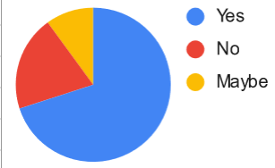
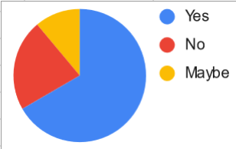
Problem Statements
Q1. Do you feel nervous about how your new match might be in real life?
10%
20%
70%
Q2.Would you like to have a free swipe counter to track your swipes for the day?
13%
22%
65%

Slide 5
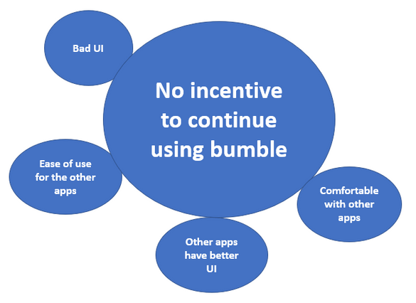
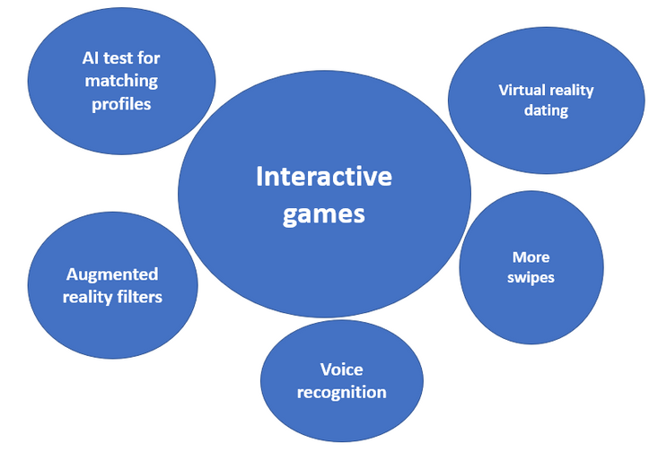
Problem Statements
Q3. Why do you shift to other platforms after matching on Bumble?
Q4. What additional features would you like to have in Bumble?

Slide 6





Features
01
BeYou
02
Swipe Counter
03
Bumble Discounts
04
Interactive Games

Slide 7




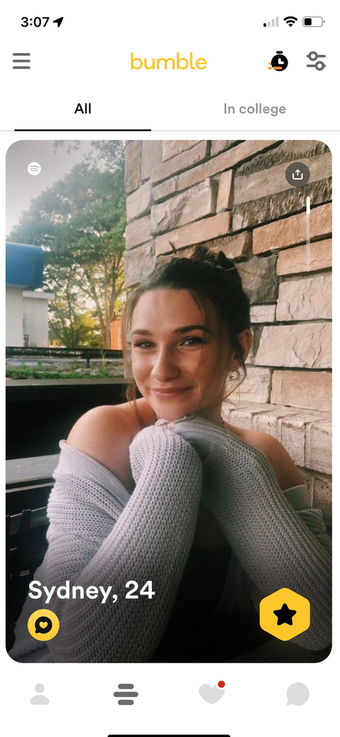



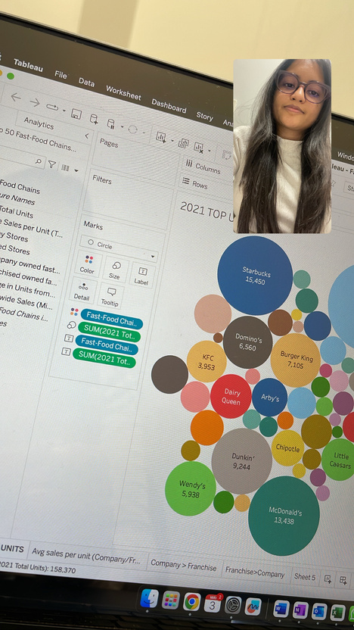
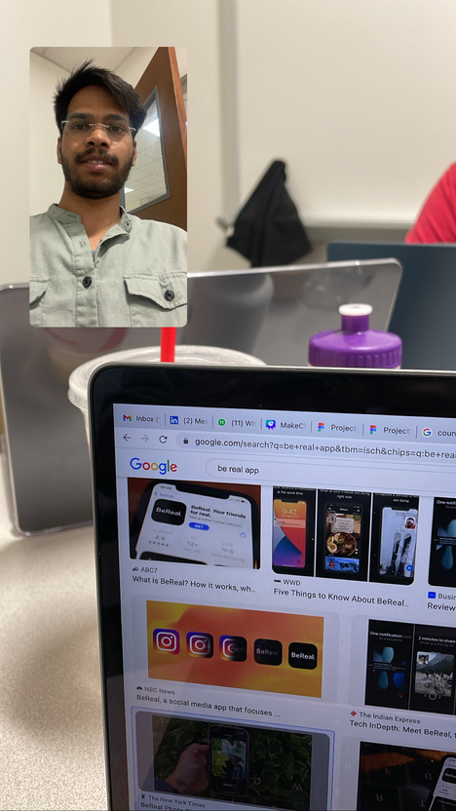

How will the new feature look
Be You
29
You
Swipe Counter

Slide 8
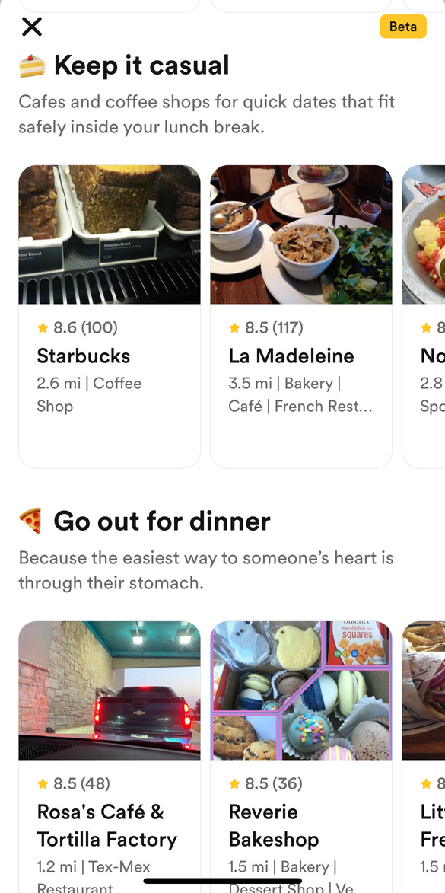
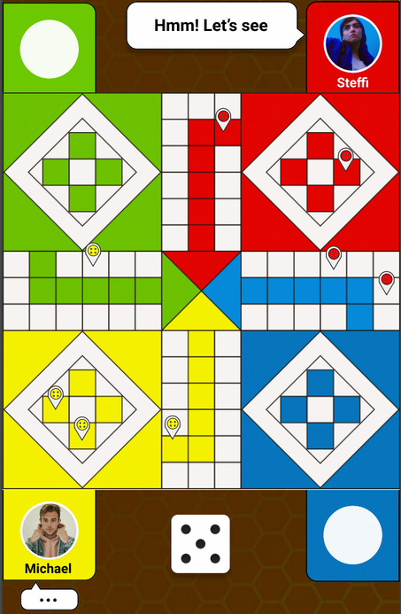
How will the new feature look
Bumble Discount
Bumble Discounts
Interactive Games

Slide 9








User Persona
5'6''
Stanford University
Talkative
Partner in Crime
Name: Anna Mathews
Gymnastics, Debate
Hanna, 28
Economics Student
Has been misled several times
on dating apps
Wishes there was a way to know more about
the person before going on a date.

Slide 10

User Persona
6'2''
Google,NewYork
Shy,
Introvert
Life Partner
Name: Anna Mathews
Reading, Movies, Football
Difficulty continuing conversations
on Bumble!
John, 33
Data Scientist
Wishes for more creative outlets to connect
with matches.

Slide 11






Customer Journey Mapping
Hey, how's the weather?
Cliched Icebreaker Prompts
Anxious, Unsure of what I am getting into
Feeling Bored
Mindless Scrolling
Poor Experience
She's too good to be true.
Feeling Adventurous
Intentional
Never Have I Ever?
Show me the real YOU!
Excited !
I can beat you in Scrabble!
Enriched Experience
Swipes Left
Open Bumble App
Start Swiping
Get Matched
Start Conversations
Online Games
Be Real Snaps
Date Ready

Slide 12
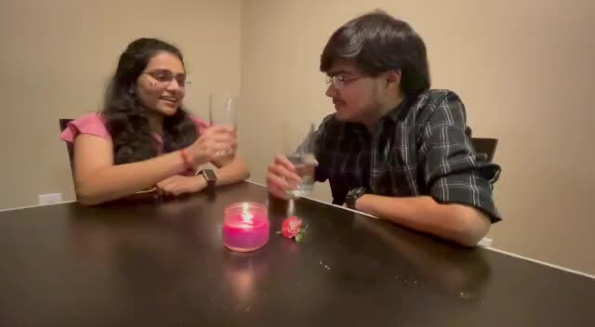

Slide 13




Competitors Matrix
High User Engagement
Low Authenticity
High Authenticity
Low User Engagement

Slide 14


Impact and Metrics to Track
Session Length
Feature Usage
Churn Rate
Customer Life Time
Engagement
Retention

Slide 15




Feature Prioritisation Matrix
Be You
Importance
Discount
Games
Count
Complexity

Slide 16
Roadmap
Badoo App
founded
Bumble App
founded
Bumble App
started to
monetize
Bumble Bizz
launched
Blackstone acquisition closed and Whitney appointed company CEO
2006
2010
2014
2016
2016
2016
2017
2020
2020
Became profitable
Bumble BFF
launched
Video chat
functionality
introduced
Company
rebranded
as Bumble
Apr'23
May'23
Jun'23
Be You
Swipe counter
Games
Discount

Slide 17


Thanks!
Do you have any questions?

